Slide 1
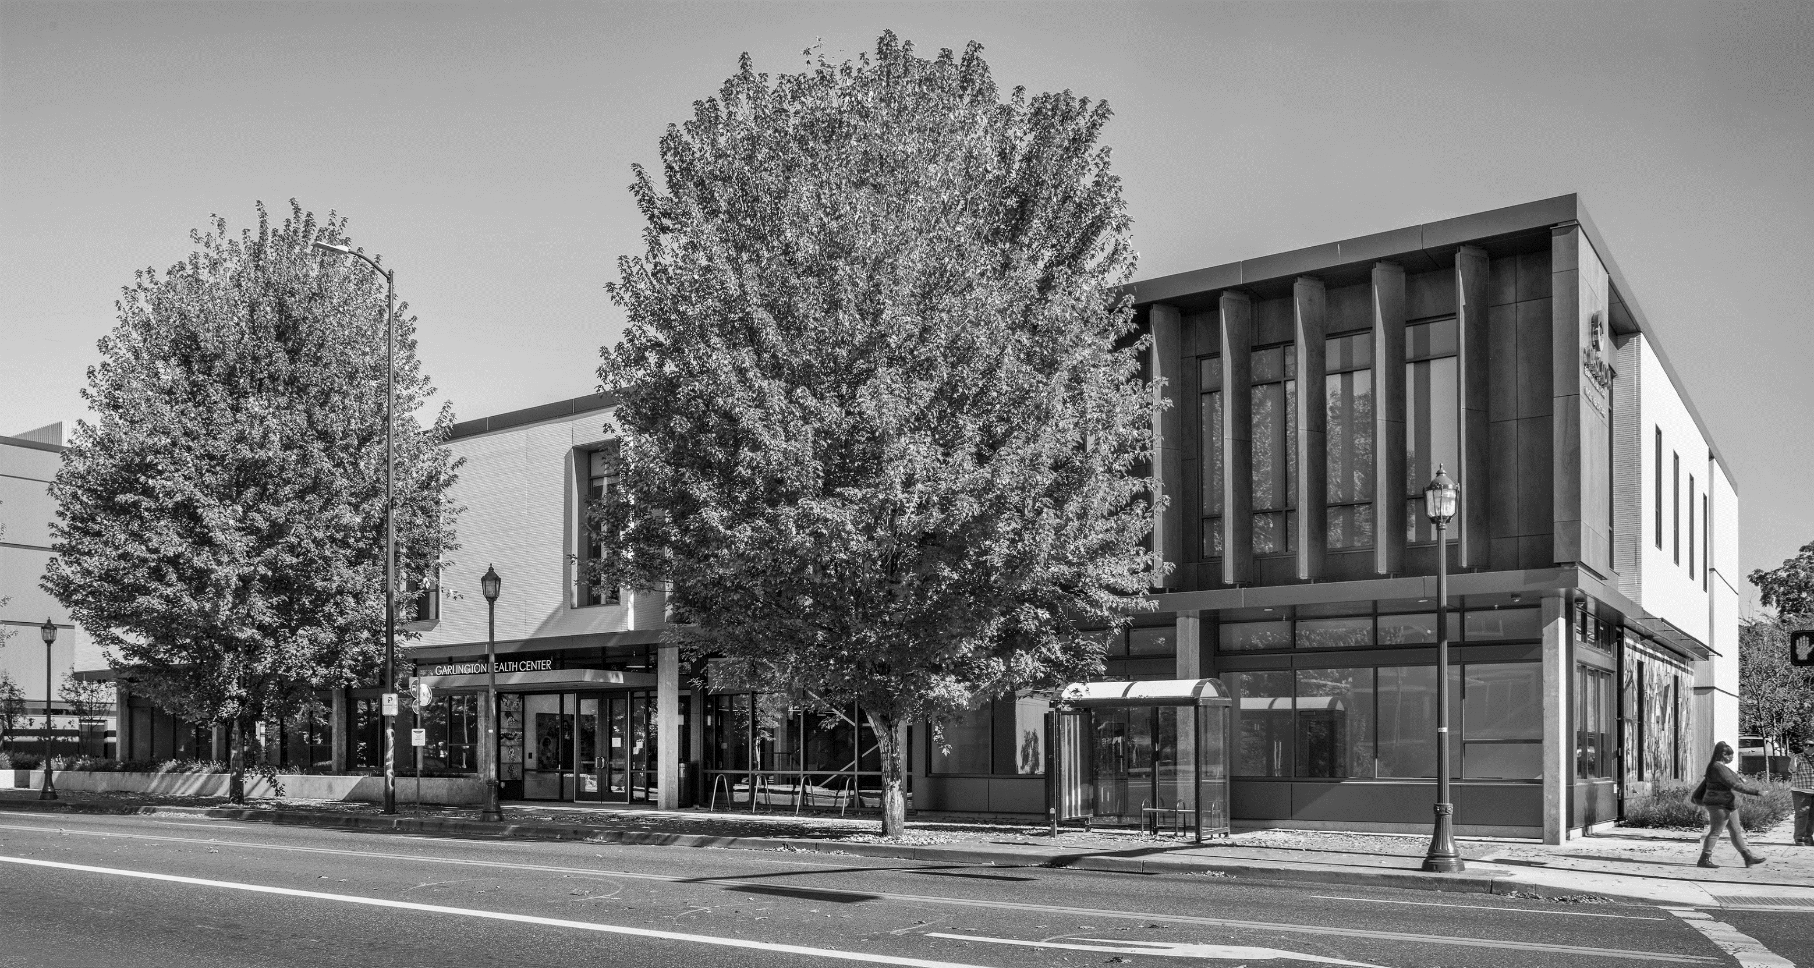
From Feasibility to Stabilization: How Asset Managers and Developers Can Collaborate to Create Operationally Resilient Affordable Housing Properties
Housing Washington Conference
September 29, 2025

Slide 2
Meet the Panel
Amy Cubbage | VP, Asset Management, Imagine Housing
Melissa Baker | Senior Asset Manager, Enterprise Community Investment
Natalie Thornton | Senior Asset Management Project Manager, Housing Development Center (Portland, OR)
Moderator: Kimberly Taylor | Director of Asset Management, Housing Development Center (Portland, OR)

Slide 3
Agenda – 90 min
Introductions, Agenda & Session Goals (10 min)
Setting the Table: AM defined, AM vs PM, AM Then & Now (5 min)
Project Lifecycle & Overview of AM during Development (5 min)
Opportunities for AM during all development phases (10 min each):
  Pre-Acquisition
  Feasibility
  Pre-Development
  Construction
  Lease-up & Closeout
Q & A (20 min)

Slide 4
Session Goals
Provide ideas and inspiration on collaboration across teams at every stage of development
Set future developments up for stability and success
Collaborate and coordinate, eliminate assumptions, and go into the operations phase with eyes wide open

Slide 5
Audience question:
Who is in the Room?
Asset Manager for Owner
Asset Manager for Investor
Property Management Staff
Developer
Finance / Accounting
Funder / Lender
Resident / Supportive Services
Other

Slide 6
Setting the Table for our Discussion:
Asset Management Defined
Successful affordable housing asset management is
the establishment of a strong foundation of financial and operational oversight of an organization’s housing portfolio and a crisp vision of long-term portfolio goals, from development to restructure.
Asset Management (and the asset manager’s role) is to ensure this oversight and vision are accomplished.

Slide 7

Asset Management Oversight
Monitor financial performance
Ex.: Project property performance over 20 years based on financial data
Monitor physical condition
Ex.: Order a Capital Needs Assessment (CNA) on an aging property
Ensure regulatory compliance
Ex.: Report to the investor after a property was damaged by fire
Oversee property operations
Ex.: Work with property management to review and improve collections policies
Strategically position portfolio for success and manage risk
Ex.: Evaluate OAHTC and conventional loan options for a property in need of mortgage refinance

Slide 8
Property Asset
Management Management
Third circle: Resident Services
Day-to-day operations | Areas of collaboration | Long-range outlook
Turn and lease units | Market units for rent | Review effectiveness of leasing practices
Complete compliance reports | Complete compliance reports | Maintain relationships with funders
Fix leaky faucets | Identify capital needs | Seek funding for building rehabilitation
Pay bills and issue financial statements | Evaluate and manage expenses | Assess property financial performance
Pursue goals through operations | Monitor progress towards goals | Evaluate operations to set goals

Slide 9
Asset Management Then & Now
Then (Ideal):
  Portfolio-level view
  Finance-focused
  Transaction-oriented
  Year 15 planning
  Long-term strategy
  Cash flow optimization
Now (Not Ideal):
  Granular level of oversight
  Operations-heavy
  Day-to-day involvement with property management
  Fewer deals per Asset Manager and capacity constraints
  Burnout!

Slide 10
Development and Asset Management
Property success is largely designed and determined during project development
AM involvement during development will bring a long-term operations perspective to a deal
AM input into a property will set you up for success!
AM can provide insight into many areas: population restrictions and services design, achievable rents, common area design, value engineering, and more

Slide 11
Project Lifecycle:
Development and Asset Management common practice
A few months of collaboration!
Development
Asset Management
Certificate of Occupancy
Year 15
Year 20
Stabilized Occupancy

Slide 12
Project Lifecycle:
Development and Asset Management recommended!
Years of collaboration!
Development
Asset Management
Certificate of Occupancy
Year 15
Year 20
Stabilized Occupancy

Slide 13
Project Life Cycle: Phases of Real Estate Development
Feasibility
Predevelop-ment
Construction
Lease Up & Closeout
Operations
Feasibility | 6 months to several years | Identify a site and engage project team to assess the physical and financial viability of the project. Identify and secure a major funding source.
Predevelopment | 1-2 years | Expand the team, finish design, submit and obtain permits, secure and close on construction funding.
Construction | 1-2 years | Get the project built and begin marketing units.
Lease Up & Closeout | 6-12 months | Lease units, transition from construction to long-term financing.
Notes:
FOLLOW UP: consider adding info about organizational funds put out vs. risk level at each phase
NOTE: Time ranges are approximate and can vary significantly from project-to-project.
Feasibility Phase – This is when an Owner will reach out to HDC us to test out a vision they have for a property or want to satisfy a service need. Our goal in this phase is to understand that vision and start to define it into a potential project. To do that we will identify and start working with an architect and general contractor, evaluate the site and conduct site due diligence, prepare an initial design and cost estimate, and build a project budget. Using these bits of data we will reach out to potential funders to determine interest and project viability... This is the phase where we will draft a funding application and secure the major funding source.
Predevelopment – Once that source is committed, we begin the predevelopment phase. The Architects will create a set of documents which the General Contractor will ultimately use to build the building. The team will submit the project to the City or County for any site development review and building permit. And the financial team will work to secure the loans, negotiate with the tax credit investor and ensure that any grant requirements are met. The culmination of all this work is referred to as the 'closing of the construction loan.'
Construction – With the construction loan in place and the agreement negotiated with the tax credit investor the real fun begins and we start construction. Weekly OAC's, pay requests, change orders will become the daily lingo as the project moves from the two-dimensions to a structure we can walk through. Anywhere from three to six months prior to the end of construction, the property management team will need to be in place and the project will begin marketing units.
Closeout – At the end of construction, one of the key documents that signals a shift to another phase is 'Substantial Completion.' At Substantial Completion, construction is (substantially) complete and the units can be occupied. Your property management team will begin the lease-up and move-in process. Property management and asset management will transition from construction mode to stabilization and will work closely with HDC's Finance PM to secure the long-term financing.

Slide 14
Audience question:
Is your asset management staff included during discussions of land or property acquisition for future development or rehab?

Slide 15
Asset Management and Pre-Acquisition Strategy
(10 min)
In private industry, deals go forward regardless of penciling
Investment Committee review process
Equal AM/Dev "voting" rights
If rehab, is it significant or just a band aid of physical issues?
Smaller orgs are having trouble meeting liquidity requirements - opportunity for smaller organizations to partner with larger orgs to leverage REO schedules and guarantees
  Ex: partnerships between private orgs & nonprofits or small housing authorities
Notes:
Natalie – developing PSH project in rural area - client unclear on project concept; Some organizations may be largely responding to jurisdictional offerings rather than purchasing plots of land, and it’s important to apply the standards you’ve developed with your asset manage
Melissa – ensuring the right team is in place to design/build/operate at the prospective site
Feasibility analysis to include community needs - will the target population needs be met within the existing community resource pool (e.g. transit, healthcare, education)
Amy – Importance of cross training (our President, HD VP, & Finance team all have AM background and/or training- consider operations), RE committee vets projects, importance of parking/transit, considering how new projects impact the org's overall risk profile (seeking balance in the portfolio)

Slide 16
Audience question:
Is your organization’s asset management and/or property management staff consulted when crafting operating projections for a new development?

Slide 17
Asset Management in Feasibility Phase
(10 min)
Establish a deal "buffer" where projects can operate comfortably despite market-driven challenges
  Ex: converting to a 1.20 DCR rather than the minimum required 1.15 DCR
Match unit sizes and set-asides to local demand
Compare max rents to market rents
Operating expense comps from similar properties
Operating expense growth trends
Realistic site staffing (FTE and pay) based on resident population
Level of services needed for resident population
Notes:
Melissa – evaluating an existing asset can be challenging to stress test; operating trends/capital improvements/historic utility data will be dependent on current owner sharing information
Sponsors with existing properties in a given marketplace have additional confidence with underwriting parameters
Investors & lenders are increasingly risk averse – 1.20 DCR as new minimum, establishing supplemental reserves at closing to ensure resources are available for early years
Amy – Underwriting as risk mitigation
Ex problem property: 50% PSH units; 2024 income 13% lower & opex 103% higher than underwritten
Dialogue with funders very important – funding priorities should align with market demand to avoid supply mismatch; Ex: Softening of demand for senior housing (especially at 50/60%+ AMI)
WA funders implementing new underwriting standards
Natalie
Softened rental market, 60% AMI rent challenges
Compare like to like – developer pro forma with 8500 OpEx Pupy but with 2000 PUPY services fee

Slide 18
Audience question:
Is your organization’s asset management staff and/or property management company consulted when determining the lease-up schedule for a new development?

Slide 19
Asset Management in Pre-Development Phase
(10 min)
Realistic financial reporting deadlines
Operating and Replacement Reserve deposit and withdrawal requirements
Year 15 exit language
DCR definition and requirements
Cash flow waterfall and fee calculations
PM Agreement, PM fee (this is a big one!), and lease up agreement
MOUs with third party service providers/between PM and services
Lease up and credit delivery schedule, lease up budget and reserve
Marketing Plan
Replacement/Capital Reserve planning
Subsidy Layering and/or Project Set-Asides (do they work in that specific geo area?)
Notes:
Melissa – integrating operational voice into design process by soliciting feedback on early concepts (while there is still time to pivot)
Engage asset management team AND services, property management and resident perspective
New construction – where and how many office spaces? Common area opportunities (adaptability is key)? Security & visibility for onsite team
Acq/Rehab - what is working well and what is imperative to shift?
Amy
Simple is ideal. Property with 9 service/referral MOUs from initial development. Referral options great, but managing set asides for multiple orgs is challenging.
Clear service & AM fee agreements (flat fee + escalator)
Natalie
Don’t assume nonprofit syndicator = easy

Slide 20
Audience question:
Is your asset management staff consulted on design and materials, such as common area layout or kitchen finishes?

Slide 21
Asset Management in Construction/Design Phase
(10 min)
Higher level of design review and feedback engagement recommended from AM/Property Mgt for PSH or high-needs communities
Are there green features, such as a green roof or living wall? Is there additional landscaping budget to maintain it?
Materials and finishes: flooring, doors, trim, paint colors
Safety: Lines of sight, cameras, keying, access control, unit numbering
Maintenance: Storage, trash areas, janitorial closets, imported parts
Notes:
Melissa – establish flow of information and feedback – integrate AM into project management (Construction updates, site walks) & installation review (especially with sensitive systems)
Project example – campus development with mix of building types, phased development
Issue: window failure in Phase 1
Solution: 3rd party contractor hired to review and sign off on window installations of each unit style for subsequent phases
Warranty Process – establish plan in advance – warranty walk and system verification (pre-lease-up), Year One issues (documentation & communication) & engaging subcontractors (flooring, HVAC, roof issues)
Project Example – high rise LIHTC building with a mix of family and PSH units
In-unit PTAC units leaking – initially preceived as resident issue, system issue was confirmed in Month 4 of operations
Solution:
Year One – documentation from site team to AM to HD to GC; quarterly meetings established to review and keep work from going stale
Rengaging subcontractors remained a challenge – recommendation: build language into GC contract to ensure issues are resolved & do not become an operational expense
Natalie – develop design standards collaboratively with AM and development; landscaping east of the cascades with a western landscape architect
Maintain healthy skepticism of promises to innovate and conserve – living walls, water recapture systems, overly hopeful solar projections
Amy
Utilizing building envelope specialist during construction to avoid costly defects
Consider staff & storage needs in the design (development standards doc). Ex: maintenance staff needs/storage often overlooked
Consider risk mitigation- & portfolio loss history. Ex: no exposed sprinkler heads! Adequate insulation for pipes in areas without heat.
Value engineering?

Slide 22
Audience question:
Is your asset management staff heavily involved in lease-up coordination with property management?

Slide 23
Asset Management in Lease-up/Closeout Phase
(10 min)
Revisit rents and the market
  Ex: Saturation of market units charging same rent as 60% LIHTC
Revisit lease up budget, staffing plans, and marketing plan
Review roles, responsibilities and processes with all partners for PSH and population set-aside referrals
Set goals and disclose them!
  Recoup of cost overruns during development (construction delays, relo budget)
  Lease up and credit delivery (and upward adjuster potential)
  Stabilization and perm conversion
Notes:
Melissa – compliance monitoring & staff training – critical moment for oversight
Establish clear protocol for leasing process – enhanced staffing & compliance expertise to support onsite team
Amy
Requesting clear stabilization metrics/requirements from lender- know how they're calculating DCR, if they're factoring in cash receipts, etc.
Consider leasing incentives for PM (share/benefit from upward adjusters)
Natalie

Slide 24
In Summary:
Asset Management Role in Property’s Life Stages
Feasibility Determine operating expenses Market analysis MOUs and community partners Compliance & rent structure LOI negotiations | Pre-Development Property Management Agreement LPA review Lender Docs review Capital reserve planning Lease up planning | Construction Input on design Review major systems (HVAC) Security & cameras Review finishes and furniture Amenities Lease up planning | Lease Up & Closeout Rent analysis Property Management engagement Market analysis & plan Review OpEx Lease up tracking and projections | Operations Achieve mission Sustain financial viability Maintain physical condition Compliance Preserve long-term portfolio

Slide 25
Let’s open the floor for questions/comments
Thanks for joining us!

