Slide 1
NE Housing Strategy: Efforts to Combat Displacement
Presentation for Housing Washington Conference
Wednesday, October 6, 2021
Leslie Goodlow, LMSW, Equity and Business Operations Manager, Portland Housing Bureau
Leslie.goodlow@portlandoregon.gov

Slide 2
Agenda
Overview and background N/NE Neighborhood Housing Strategy
Goals and progress through 12/2020
N/NE Preference Policy
  PSU Study
Next steps
Questions

Slide 3

Background & History
2013 – PDC made a deal with Trader Joes to build a store in the heart of NE Portland
2014 – 50+ community members met with Mayor Charlie Hales protesting the deal and asking for funds for housing
2014- Mayor Hales pulled $20 Million from PDC to provide specific funds for housing that would assist with both displacement and gentrification. With the caveat that the community, be involved in deciding how the funds were spent
2015 – N/NE Housing Strategy adopted by Portland City Council
Portland Development Commission

Slide 4
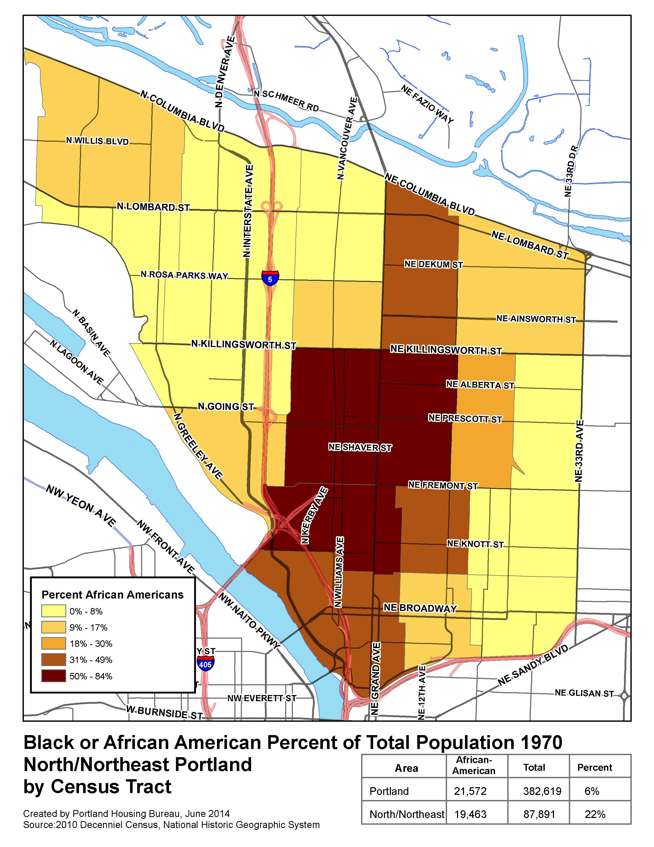
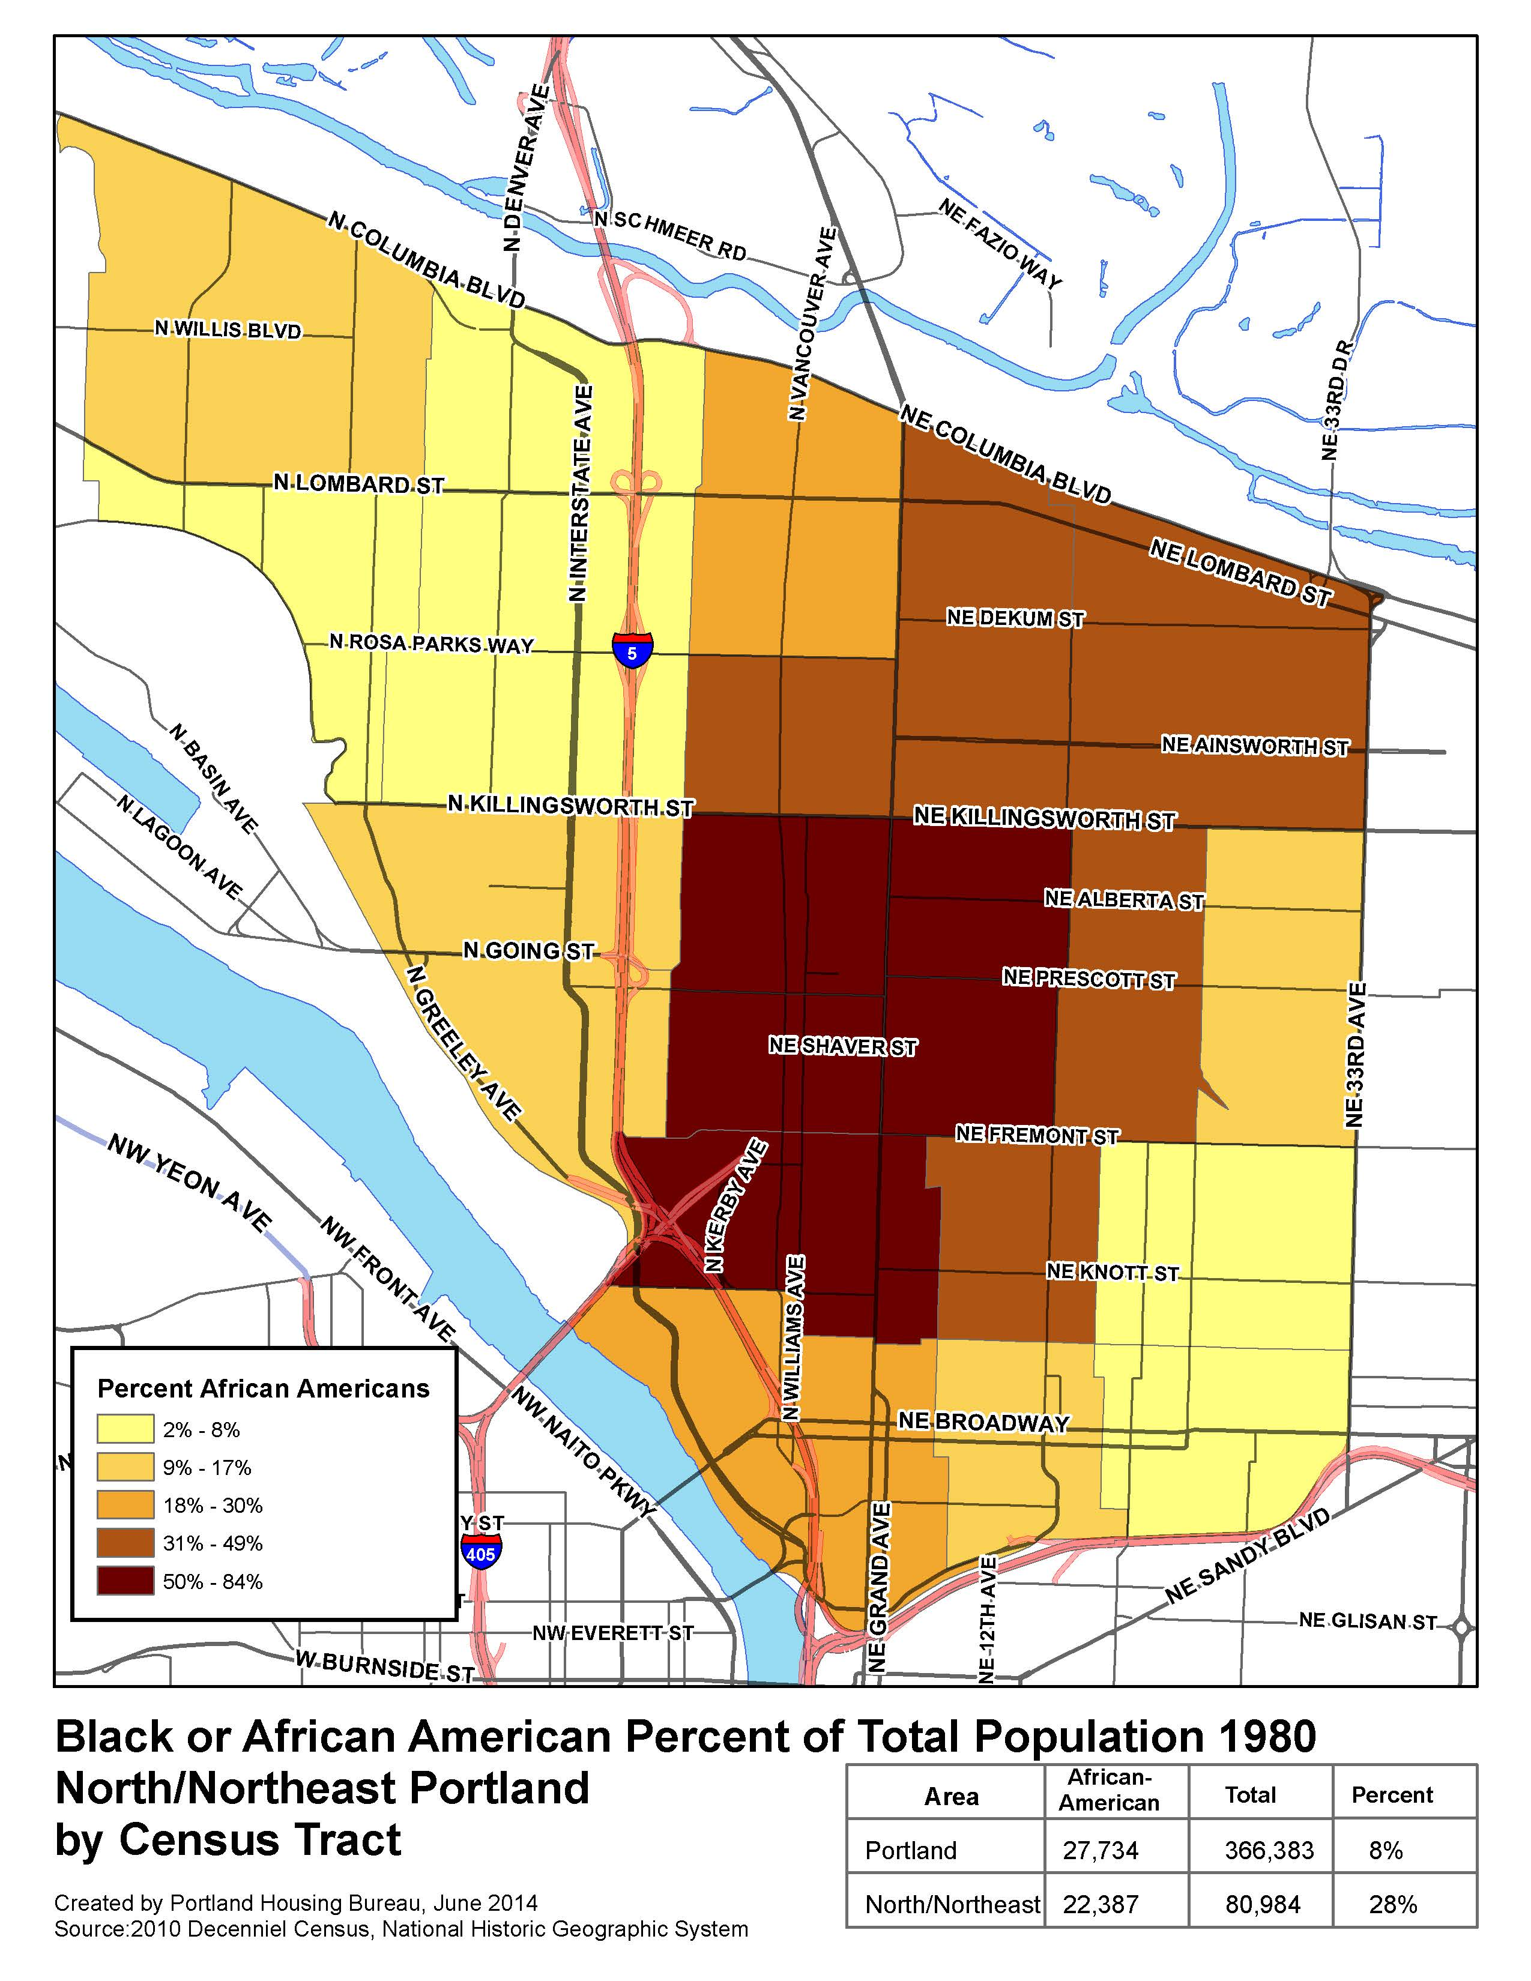
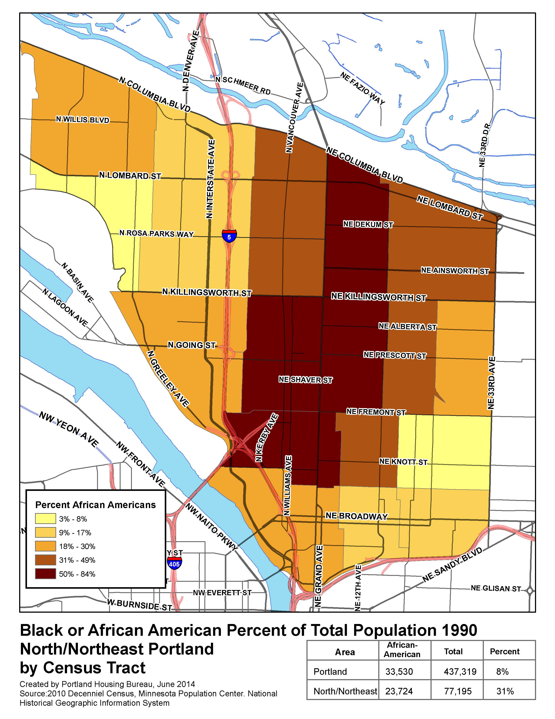
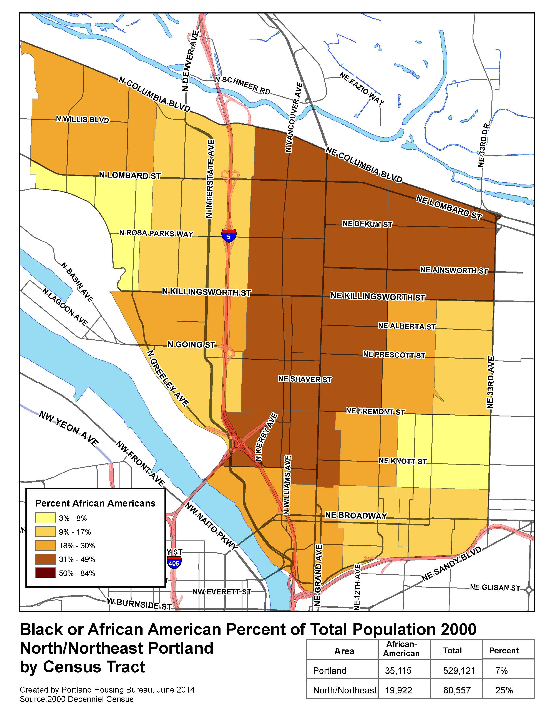
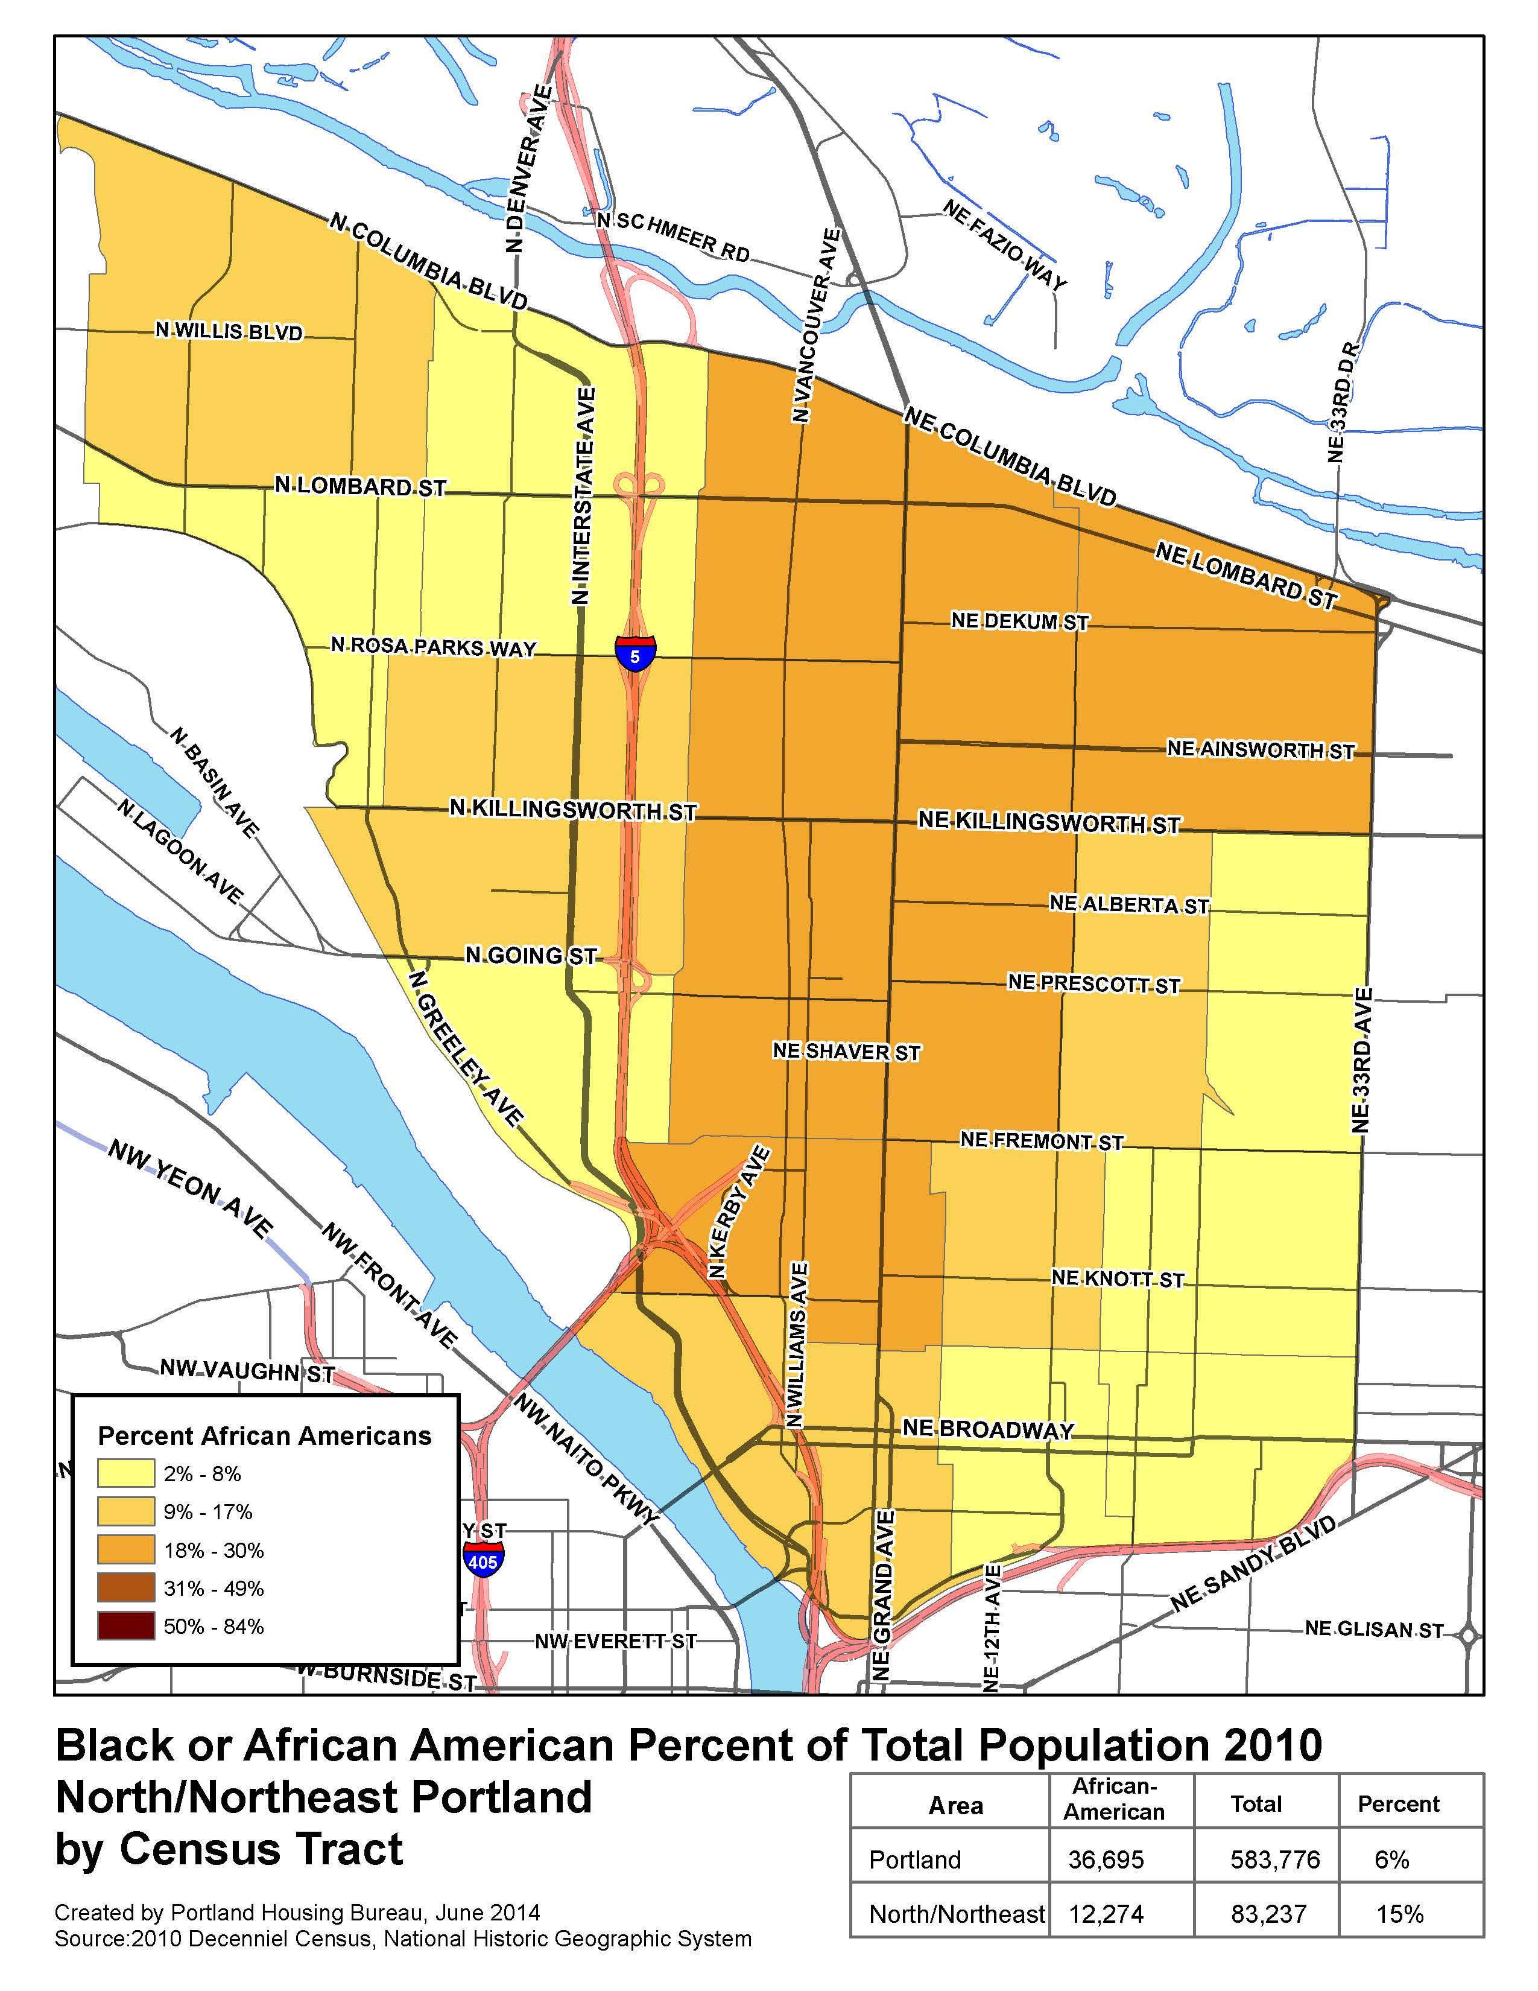

Slide 5
Demographic Data
Interstate
MLK-Alberta
St. Johns

Slide 6

N/NE Neighborhood Housing Strategy
Goal 1: Preventing Displacement - $4,000,000
  Home repair loans 80 families = $3,200,000
  Home repair grants 160 families = $800,000
Goal 2: Creating New Homeowners - $5,000,000
  Down Payment Assistance loans 40 families = $2,400,000
  Development/Construction new units 32 families = $2,600,000
Goal 3: Creating Rental Homes - $8,000,000
  Grant Warehouse Property 50-80 units = $4,500,000 plus land
  Project to be determined 30-60 units = $3,500,000
Goal 4: Land Acquisition/Banking = $3,000,000
Oversight Committee
Preference Policy

Slide 7
Strategy 1: Preventing Displacement

Slide 8
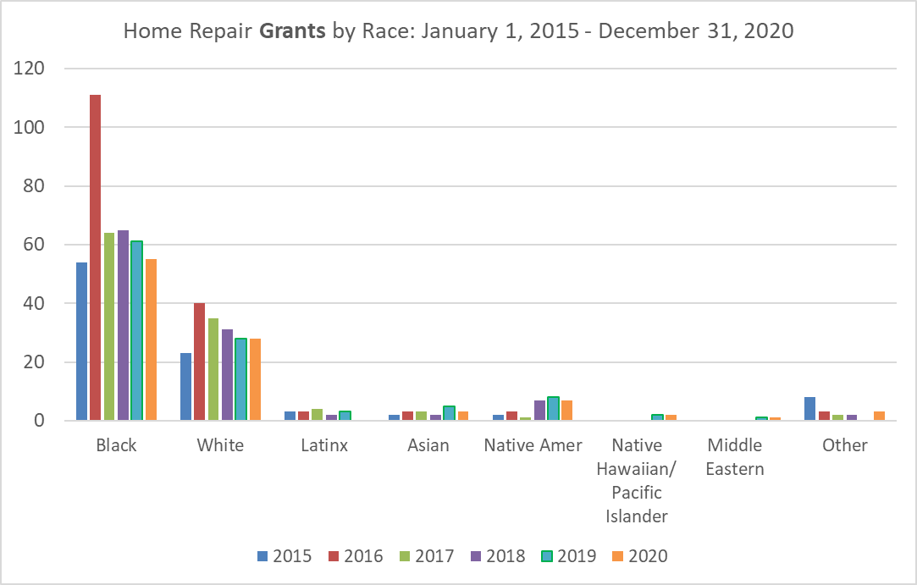
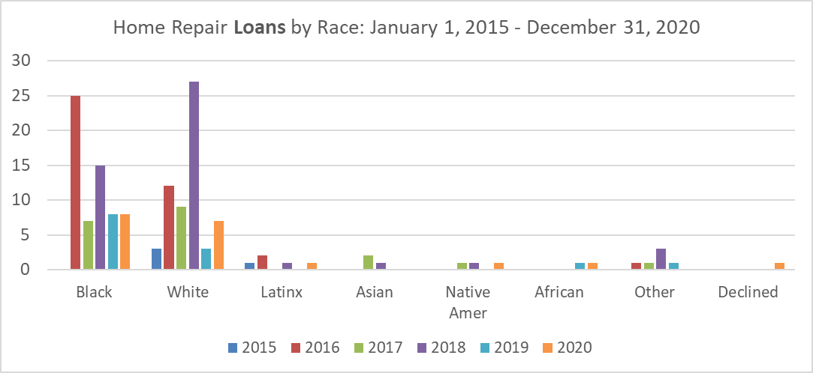
Strategy 1: Preventing Displacement

Slide 9
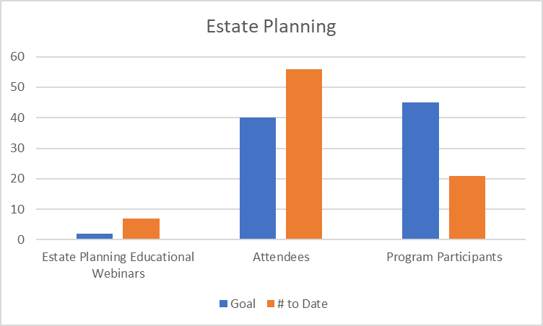
Strategy 1: Preventing Displacement – Asset Preservation Pilot
Notes:
80 PBS8 units
17 PSH units
67 at 30% AMI
57 studios
182 one bedroom
189 2 bedroom
70 3 bedroom

Slide 10
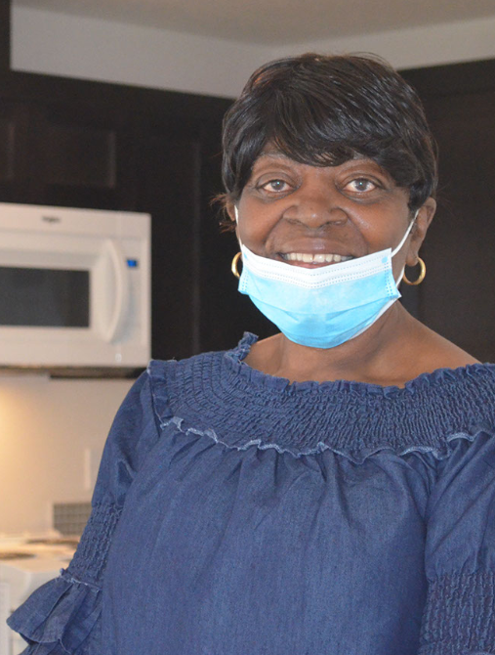
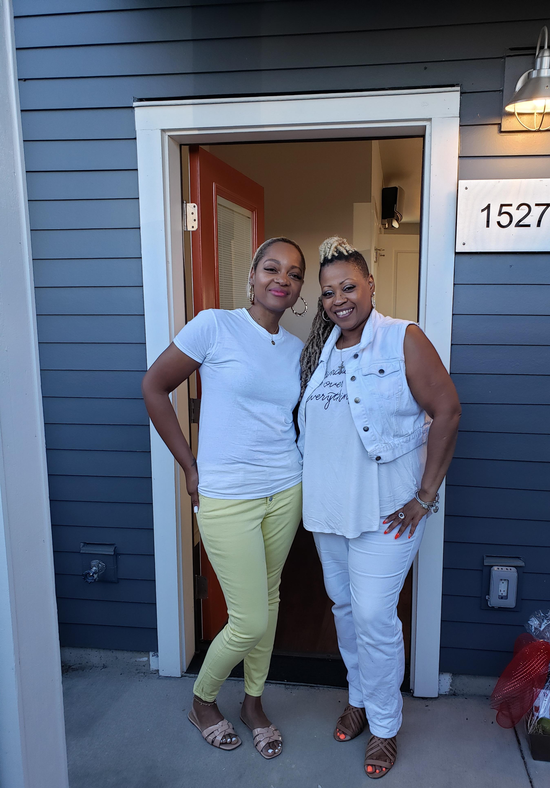
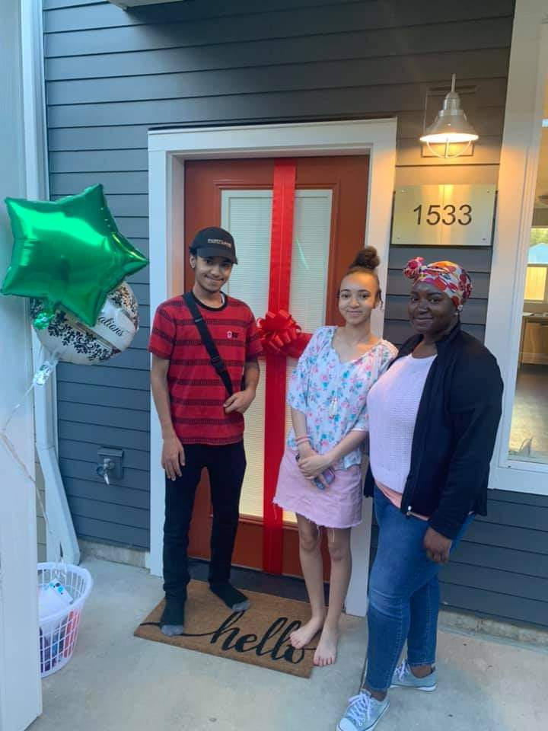
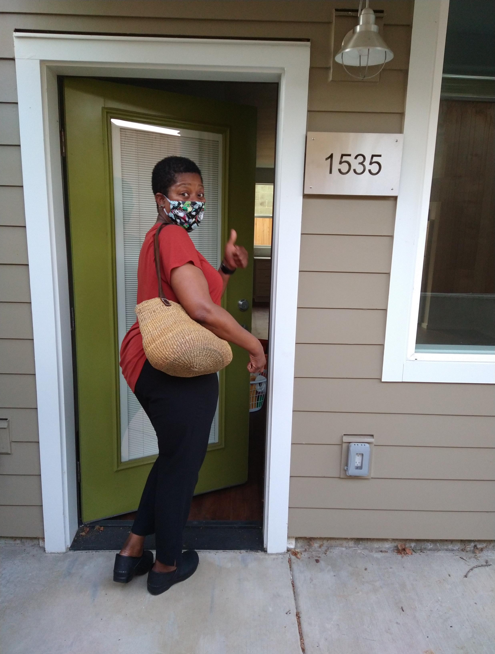
Strategy 2: Creating New Homeowners

Slide 11
Strategy 2: Creating New Homeowners
Preference Policy Home Buyers by Funding Source
Notes:
75 New Home Buyers Identified through the N/NE Preference Policy
65 of which purchased with PHB subsidies/investments – 59% of Goal

Slide 12
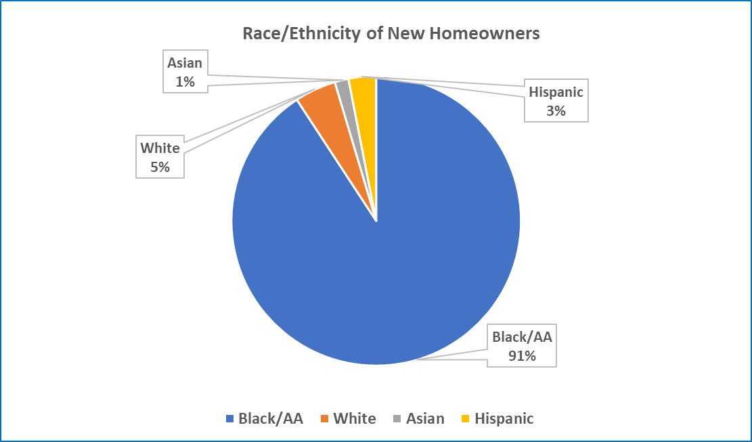
Strategy 2: Creating New Homeowners

Slide 13
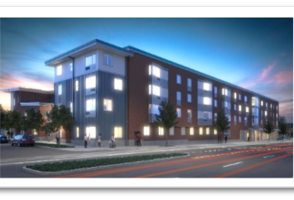
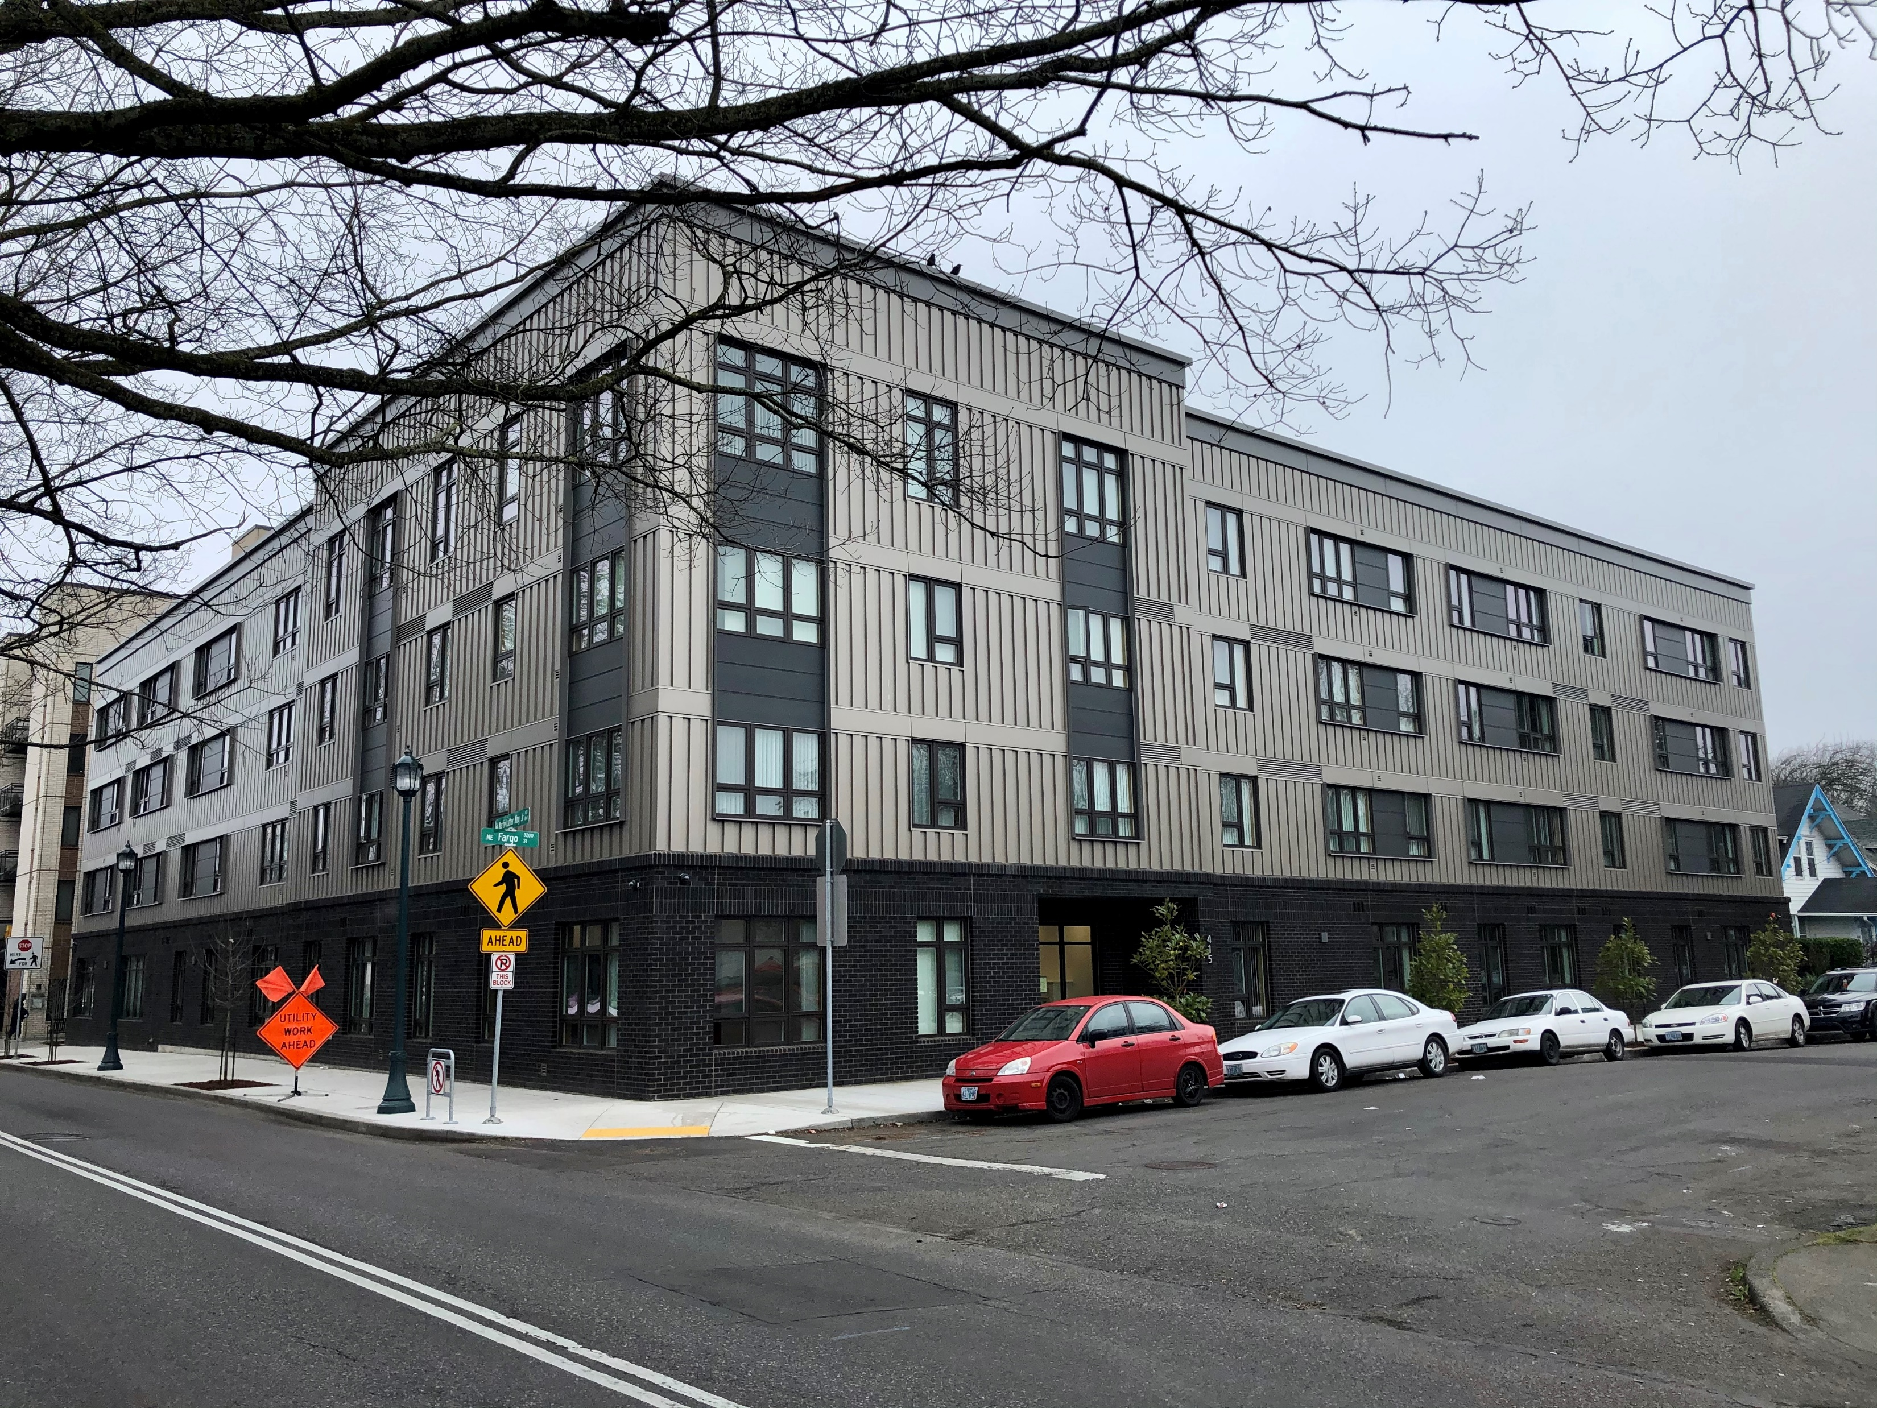
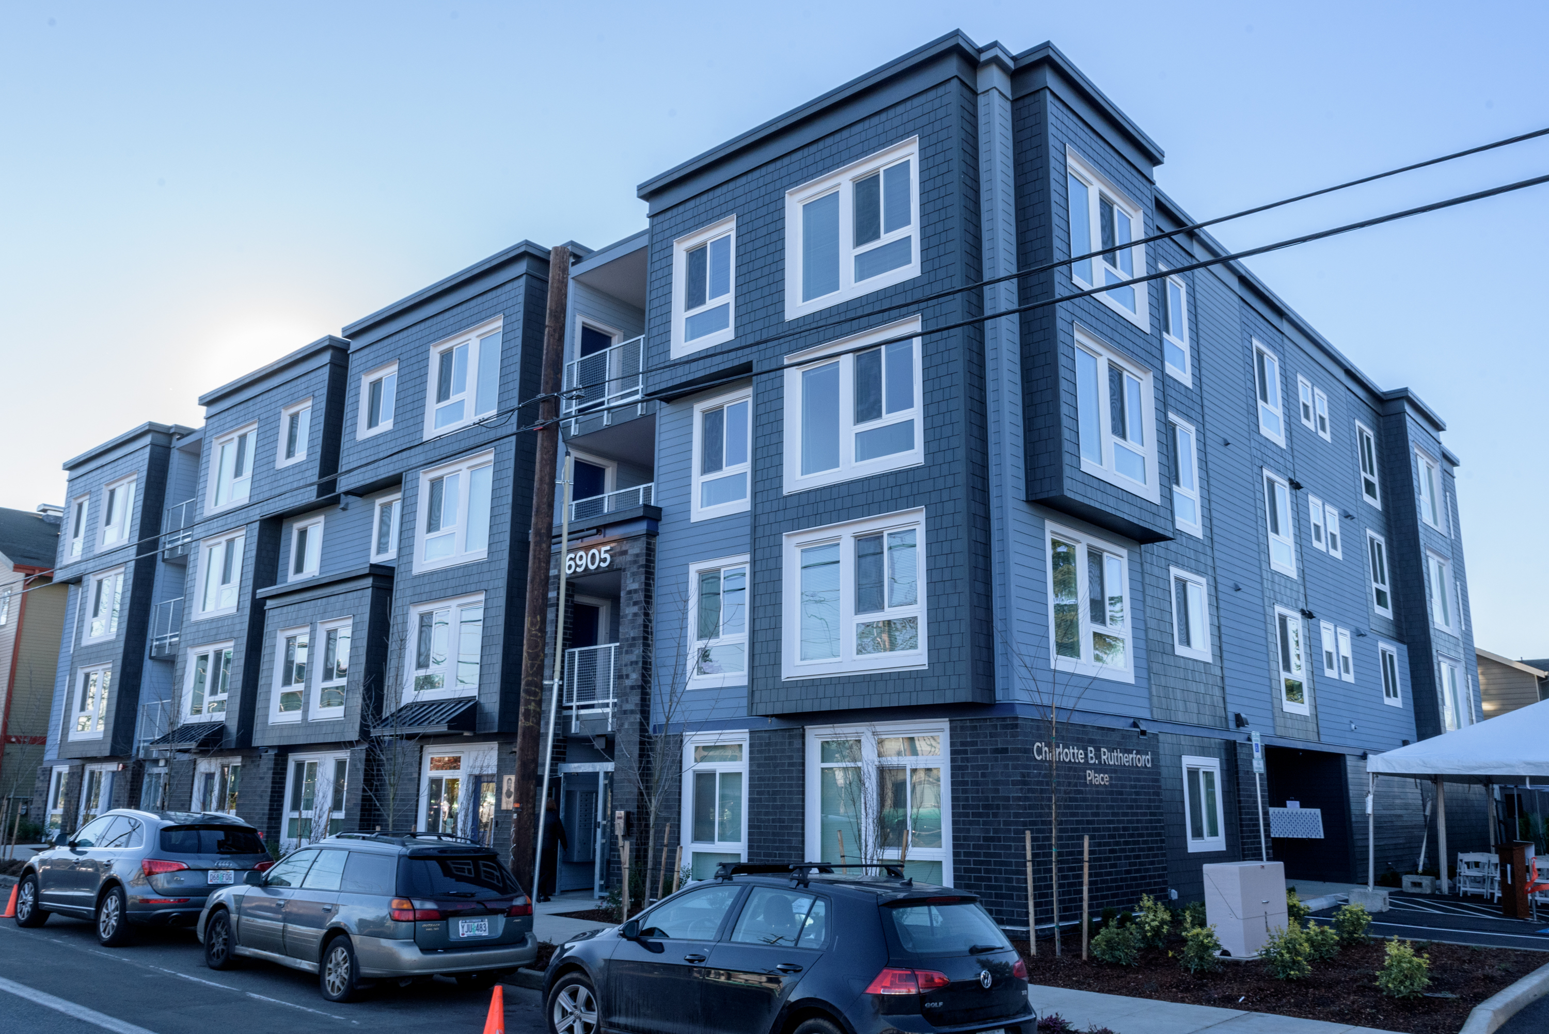
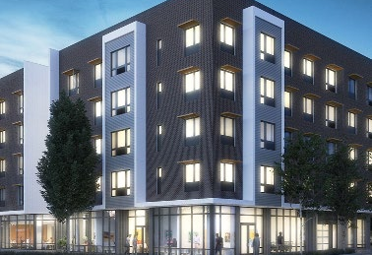
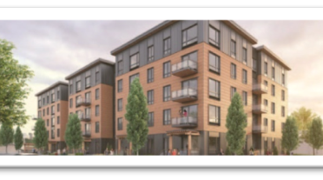
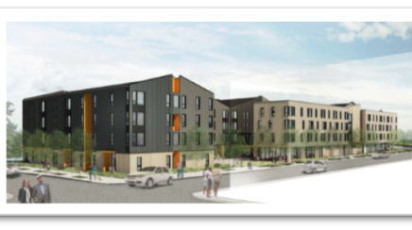
Strategy 3: Creating Rental Homes
King+Parks = 69 Units
Magnolia II = 50 units
Charlotte B Rutherford Place = 51 units
Beatrice Morrow = 80 units
Songbird = 61 units
Renaissance Commons = 189 Units
Notes:
Magnolia – Dec 2019 (now open)
Songbird – June 2020
Renaissance Commons – July 2020
King Park – July 2020 / should be 70 units (include 1 managers)

Slide 14
Strategy 3: Creating Rental Homes
PHB has exceeded the goal of 380 rental units, with a total of 501 units between 6 buildings. Leasing is complete in all but two buildings.
52% of the units are family sized with 2+ bedrooms
We are serving very low-income families through a combination of Project Based Section 8 vouchers and PSH.
Approximately 1254 people will be housed in these units
Notes:
80 PBS8 units
17 PSH units
67 at 30% AMI
57 studios
182 one bedroom
189 2 bedroom
70 3 bedroom

Slide 15
Strategy 4: Land Banking
Strong family property to be developed after a community engagement process utilizing the new tif funds from increasing the maximum indebtedness
Carey blvd property to be developed as home ownership units after a community engagement process utilizing the new tif funds from increasing the maximum indebtedness
5020 n. interstate phb released this property in the Metro Bond solicitation this past Summer as a rental project

Slide 16
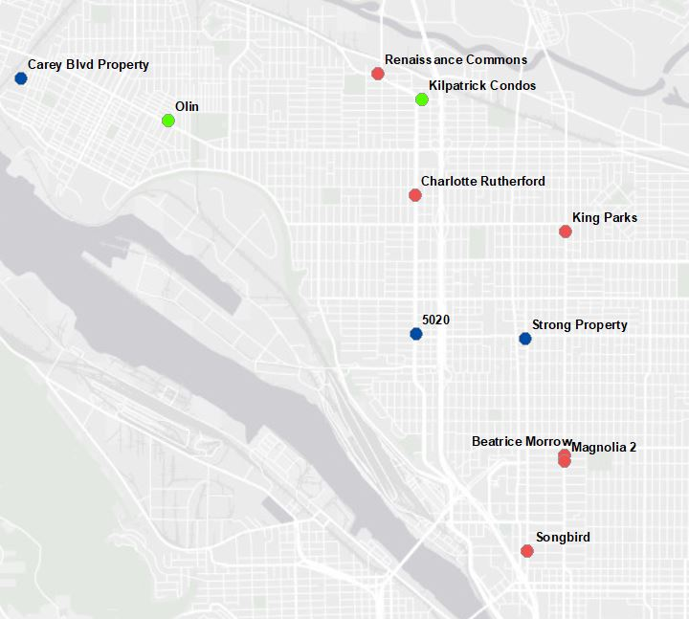
PHB N/NE
Investments

Slide 18
Oversight Committee Members
https://www.portland.gov/phb/nne-oversight/about
Dr. Steven Holt, Committee Chair, Sr. Pastor Kingdom Nation Church
Dr. Lisa Bates PhD, Associate Professor, Portland State University
Gabrielle Mercedes Bolivar, Executive Director Mainspring
Triston Dallas, Attorney, Landerholm Family Law
Dr. Karin Edwards EdD, President, Clark College
Jilian Saurage Felton, Director Housing Development, Community Partners for Affordable Housing
Felicia Tripp Folsom, Executive Director, Empowering Leaders The Contingent
Sheila Holden, Retired, Regional Community Manager Pacific Power
Marlon Holmes, Teacher, POIC/Rosemary Anderson High School
Virgie Ruiz-Houston, Retired Self Enhancement Inc
Aquiles Montas, Family Resource Coordinator, Metropolitan Family Services
John Washington, Owner/Editor Flossin Media and Executive Director SDBA

Slide 19
N/NE Housing Strategy
Preference Policy

Slide 20
Goals of the Preference Policy
Preference based on amount of urban renewal activity where applicants have lived
Addresses resulting generational displacement
Preference given regardless of current address
Top priority is applicants whose family property taken by the city

Slide 21
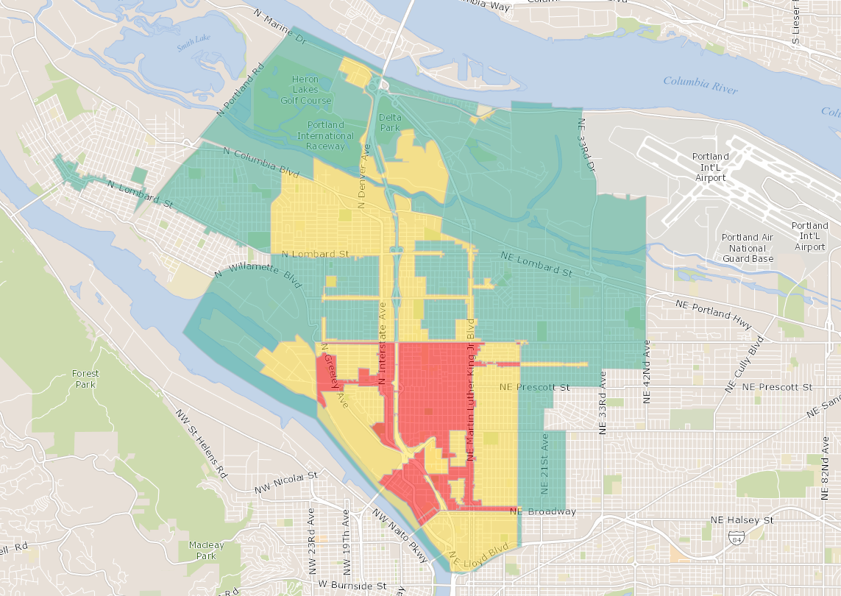
Albina Community
Plan Boundary (Green)
+
Urban Renewal Areas (yellow)
+
Areas of City Condemnation Actions (red)
0 Point Area
1 Point Area
2 Point Area
3 Point Area

Slide 22
Online Preference Policy application
https://www.portlandmaps.com/bps/phb/preference/

Slide 23
Preference Policy Application
6 rounds of preference (2 home ownership and 4 for rental)
5700 individuals have applied for preference
Preference policy as is currently open continuous

Slide 24
N/NE Housing Strategy
Preference Policy – Study by Portland state university

Slide 25
The Impact of the Preference Policy on Wellbeing
Broad Goals
Initial Objectives
  To understand resident’s motivations for applying to the Preference Policy.
  To learn about resident’s experiences in the neighborhood and sense of community well-being.
  To begin to gather recommendations to improve social, cultural, civic, economic, and environmental well-being.
To understand the experiences and needs of those served by policy.
  To assist the Oversight Committee and Portland Housing Bureau in evaluating the policy and shaping ongoing implementation.
  To inform similar policies across the county.
Notes:
As a reminder- there are a few broad goals of this study:
- First – this policy was designed to serve a particular population of folks – those who had been displaced from the neighborhood in the past – and it’s critical to know how it’s working. As you wrote in your 2017 report – we need to make sure families can do more than exist. But to find out how folks are doing in this changing neighborhood – have to ask them…
Hearing directly from residents can assist both this body and PHB in evaluating the policy, and also imnfor the ongoing implementation of the policy. We didn’t want to miss the opportunity to learn from residents ways to make this work even better. We anticipated the study might surface possibilities for community collaboration to enrich experiences of residents…
Finally- As the Preference Policy is the first of its kind in the nation, findings of this study are expected to be of broad interest. As you know, the patterns of displacement and gentrification are not unique to Portland, and planners and city housing organization are watching Portland to see how this works; community advocates want to know how this works. If we can share some best practices and lessons learned, that will be a great help to other communities…
In summary – we want to understand how this is working here, help identify ways to improve it, and share what we learn…
We see this as a longitudinal study – it will take time to fully understand the impacts on residents and the broader community. As a starting point this summer, we had the following objectives:…IMPORTANT to note – this is not an evaluation of how people feel about the quality of their housing, or their relationship with the housing providers, it’s trying to get at the heart of the preference policy itself – which was a belief that families displaced from this community ought to have the opportunity to live in this community – and now that they are back…how does it feel? How is it going?

Slide 26
1. The preference policy is serving the intended population.
Age range 19-71 average 43
Lived in the neighborhood an average of 32 years: on average, lived 72% of life in the neighborhood; 65% lived entire life in the neighborhood.
84% Black
68% Women
54% had no children living in the home

Slide 27
2. One of the central underlying themes of the policy is that “place matters”
80% reported their connection to the neighborhood was their primary motivation for applying
80% believed this was best chance to move from waitlist into housing
Convenience to work or school was NOT a primary motivation
91% agree that the history of this neighborhood matters to me
87% feel I belong in this neighborhood
83% have friends and family in neighborhood

Slide 28
78% participate in arts and cultural events
53% indicate increased participation since moving in
56% spend time volunteering
24% report increased civic engagement since moving in.
50% report getting to work and/or school is more convenient
3. Residents are generally experiencing improvements in their well-being

Slide 29
4. … and residents also reported risks/vulnerabilities to their wellbeing.
Only 48% agreed that people who want to can find a good job in the neighborhood.
Some are still precariously housed.
Most interviewed described needs for more low-cost stores and amenities
70% agree that people different backgrounds get along
37% agree there’s “a lot” of prejudice in the neighborhood.
30% experienced discrimination in area businesses

Slide 30
Take-aways
Being able to live in the neighborhood where you have strong place attachments and social ties matters deeply to many.
Residents experience their situations as improved, AND they experience tensions/threats to well-being.
Affordable housing is necessary but not sufficient.

Slide 31
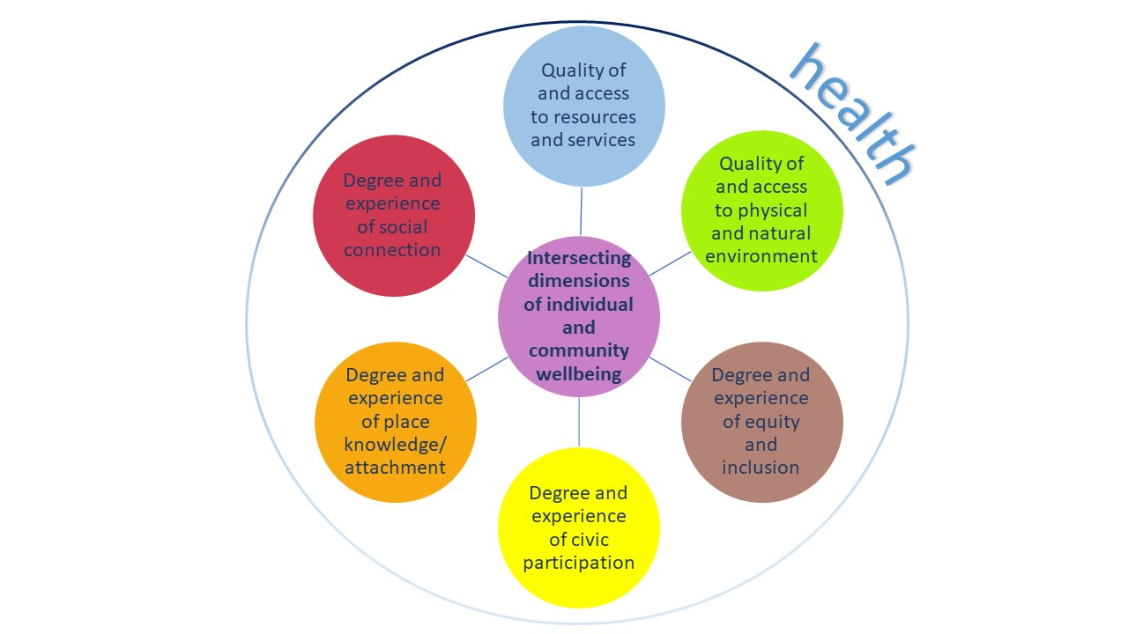
Conceptualizing Community Wellbeing
Notes:
One way of thinking about this is that there are multiple dimensions that impact wellbeing …
Based on what we are learning so far- there are so ways residents housed through PP seem to have particularly strong well being – social connections, place attachments, and civic engagement

Slide 32
Looking Ahead
Complete analysis
Report findings to housing partners, residents, and other stakeholders
Vet interest in Participatory Action Research with residents to address some of their concerns
RWJ Grant awarded in 2020 to continue study

Slide 33
QUESTIONS?

Slide 34
Additional Information:
1. N/NE Neighborhood Housing Strategy Webpage: https://www.portland.gov/phb/nnehousing
2. Portland 2020 State of Housing Report: https://www.portland.gov/phb/state-of-housing-report
3. Washington Post: https://www.washingtonpost.com/realestate/fostering-development-without-displacement/2020/07/29/773bef2a-484a-11ea-8124-0ca81effcdfb_story.html
4. PBS Newshour: https://www.pbs.org/newshour/show/black-families-were-pushed-out-of-portland-can-this-program-help-more-return

Slide 35
Summary
Maximum indebtedness – In Fall of 2017 the OC was made aware that all rental development funds had been allocated to projects, and additional funding could be available through the process of maximizing indebtedness for the district. The committee supported moving forward with the investigation of the possibility to increase available funds through this process. Prosper Portland and Portland Housing Bureau gave several briefings to the OC which led the committee to provide an official recommendation in support of maximizing indebtedness to Prosper Portland’s Board in January 2020. The committee thanks all the jurisdictional partners who supported this effort, specifically Multnomah County, Portland Public Schools and Metro, and City Council approving this effort in January of this year.
5020 not going forward – A combination of mitigating elements that created the perfect storm that impacted the project’s progress: financing, HOA fees, COVID, and lack of interest by preference policy purchasers. In September PHB and Proud Ground made the difficult decision to cancel the project. We want to thank Proud Ground and their project partners for all the work and effort that went into creating the project.
There is an ongoing need and desire for affordable housing units in NE Portland, 1700+ people applied for the preference policy in 2020 to take advantage of the opportunity to live in North and Northeast Portland. This demonstrates strong desire for place and community. Necessity versus opportunity is the mitigating issue. When the opportunity is provided to move back or to stay in N/NE Portland, people will take it, and the preference policy provides that opportunity.
We are aware of the need for broader geographical placement of projects, there is a concentration of affordable housing projects on MLK. Affordable housing should be woven into the entire fabric of the community, not just isolated to a specific street or zone.
There have been leasing challenges of the two of the three new buildings utilizing the preference policy. The committee has concerns about the lack of culturally specific staff working in the leasing office, it should not have been surprising to them about what the committee were asking of them. Although, COVID did have some impact on the delays in lease up, there were many other issues that compounded their ability to move people in. Our expectation is that partners understand that this is a community that has been traumatized over decades, that staff are trained on the history of this community and that wherever possible the first point of contact is from the BIPOC community.

Slide 36
Opportunities
Coordination of efforts - unlike any time in our history there is significant investment and concentration on what was the historic Albina neighborhood. The I-5 Rose Quarter expansion Project, the Williams and Russell Project, Albina Vision Trust, and the work of this Oversight Committee means that there are over One Billion dollars being released in this community. It is imperative to capture this incredible collaborative opportunity and to strategize for the generational advancement that this can leverage. It will require the coordination of many agencies and thoughtful leaders. But this moment cannot be missed. While we know that what was lost cannot be completely recovered, we must also acknowledge that we cannot miss this moment and cause further damage. My hope is to see each agency leader seize this responsibility and work for the legitimate good of the community that has been historically harmed.
While the initial intent was to utilize the 5020 property for home ownership (as identified already), the hard work and preparation that went into the original plans now offer rental opportunity. The plans, renderings and time will not go wasted. 60 units of affordable rental housing will be developed at this location. Portland Housing Bureau staff have presented an initial plan for the funds that were allocated to the 5020-condo project. The committee supported the recommendation to utilize $1.5 million for DPALs for families that are currently mortgage ready. We will continue to work with them on planning for the remaining dollars from that project.
Dr. Lisa Bates and Dr. Ami Thurber received a $250,000 grant from Robert Wood Johnson Foundation to continue and expand the evaluation of the North/Northeast Housing strategy's preference policy as a support to health and well-being, and racial justice. The funding includes resources to support community members both as participation incentives and for a group who will serve as project advisors. The importance of this work is that it creates opportunity to capture the significance of place for those who can take advantage of the preference policy.
Community engagement and planning for the two land banked properties will be a focus of 2021 for the committee. The Strong family property on Alberta and the Carey Blvd property have the potential of creating community, creating new homeowners and potentially support for small business. We look forward to working with PHB on these planning processes.
We, the Oversight Committee along with the housing bureau have requested a decision package of approximately $300,000 to provide stable and ongoing funding for the administration of the preference policy. While we understand that the bureau has additional TIF resources at this time due to the increase approved through maximum indebtedness, TIF resources will be depleted with the completion of the three planned projects. The units will be regulated affordable for 99 years and require the preference policy to lease them. Additionally, we understand that the bureau has had to hire temps each year to administer the program, with permanent funding they could hire staff to work year-round on this effort to support a community that has been devastated by gentrification and displacement. We ask that City council include this ask in the FY 21/22 budget.

